Slide 1
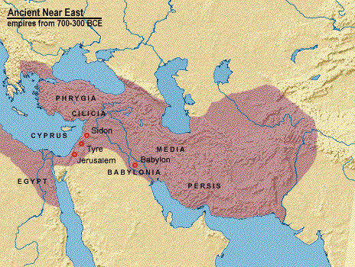
1.3 The Persian Empire (536 - 331 B.C.)

Slide 2
Historical Transition
The Old Testament ends with the Jewish people reestablished in their land. During the time from Malachi to Christ, the people of Israel lived under six different governments:
The Persian Empire
The Greek Empire
The Ptolemies of Egypt
The Seleucids of Syria
Self-rule of the Maccabees (Hasmoneans)
The Roman Empire

Slide 3
Israelites under Babylonians
During this period of world history, it was common for there to be one, single world power.
Babylonians (Babylon is modern day Iraq) were the superpower at the time.
King Nebuchadnezzar II laid siege to Jerusalem, culminating with the destruction of the city and temple in 587 B.C
Jewish Diaspora - many were forced into exile, some were allowed to stay
Babylon was famous for its
culture – these hanging gardens
were part of that. In the
background you can see the
Tower of Babel

Slide 4
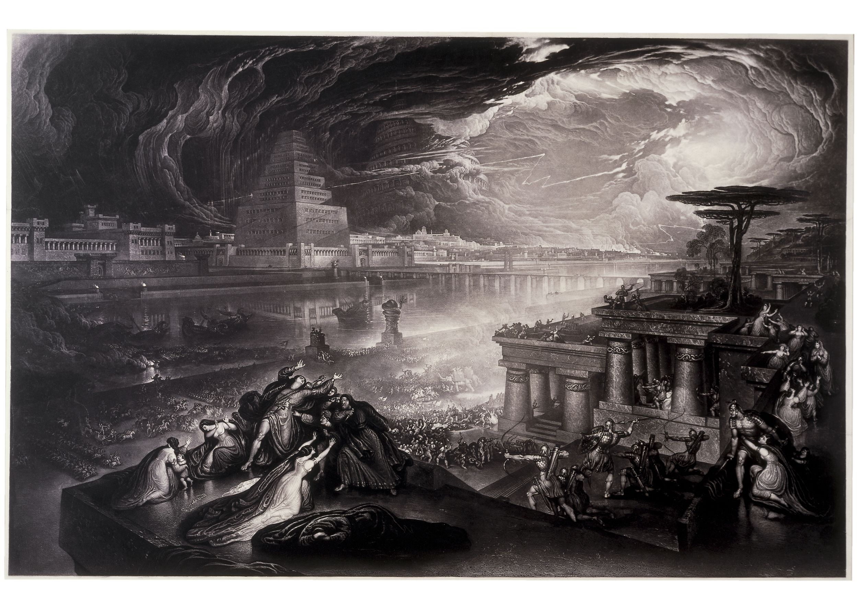
Fall of Babylon (539 B.C.)
The fall of Babylon is the term associated with the end of the Neo-Babylonian Empire after it was conquered in 539 B.C.
Cyrus the Great, ruler of the Persian Empire, led the invasion
Babylonia became a colony of the Persian Empire, and Cyrus the Great became the legitimate successor

Slide 5
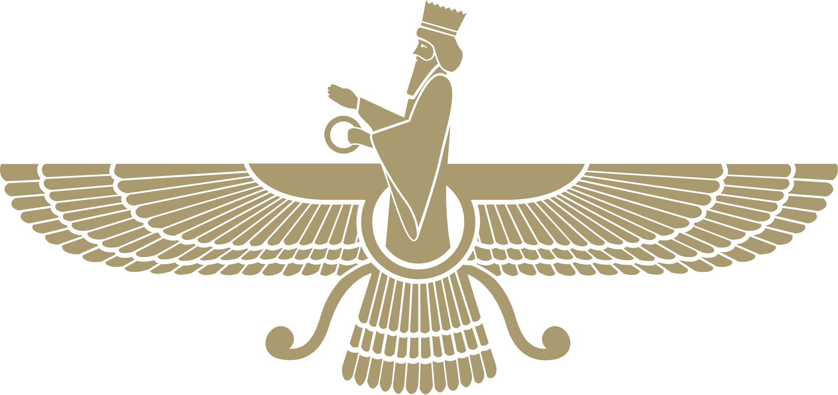
Cyrus the Great
Cyrus the Great and the Persians had a different view of governing
They believed it was better to let conquered people’s (like the Babylonians) keep their religious and cultural traditions
Cyrus’s policy was to allow people exiled by the Babylonians to return to their homelands, rebuild, and reinstitute their forms of worship

Slide 6
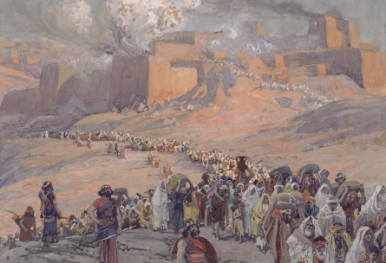
Jerusalem Restored
From 538 - 430 B.C., may Jewish people returned to Judea, restored Jerusalem and rebuilt the Temple
Cyrus the Great actually decreed that the Jewish Temple was to be rebuilt
Jews that remained in Mesopotamia enjoyed prosperity
The rise of Cyrus and the Fall of Babylon were viewed as the work of God by the Jews
Historical narratives (Ezra, Nehemiah, Esther)
Jews lived without interference for the next 200 years

